Slide 1

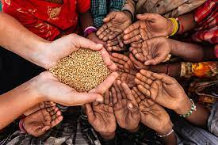
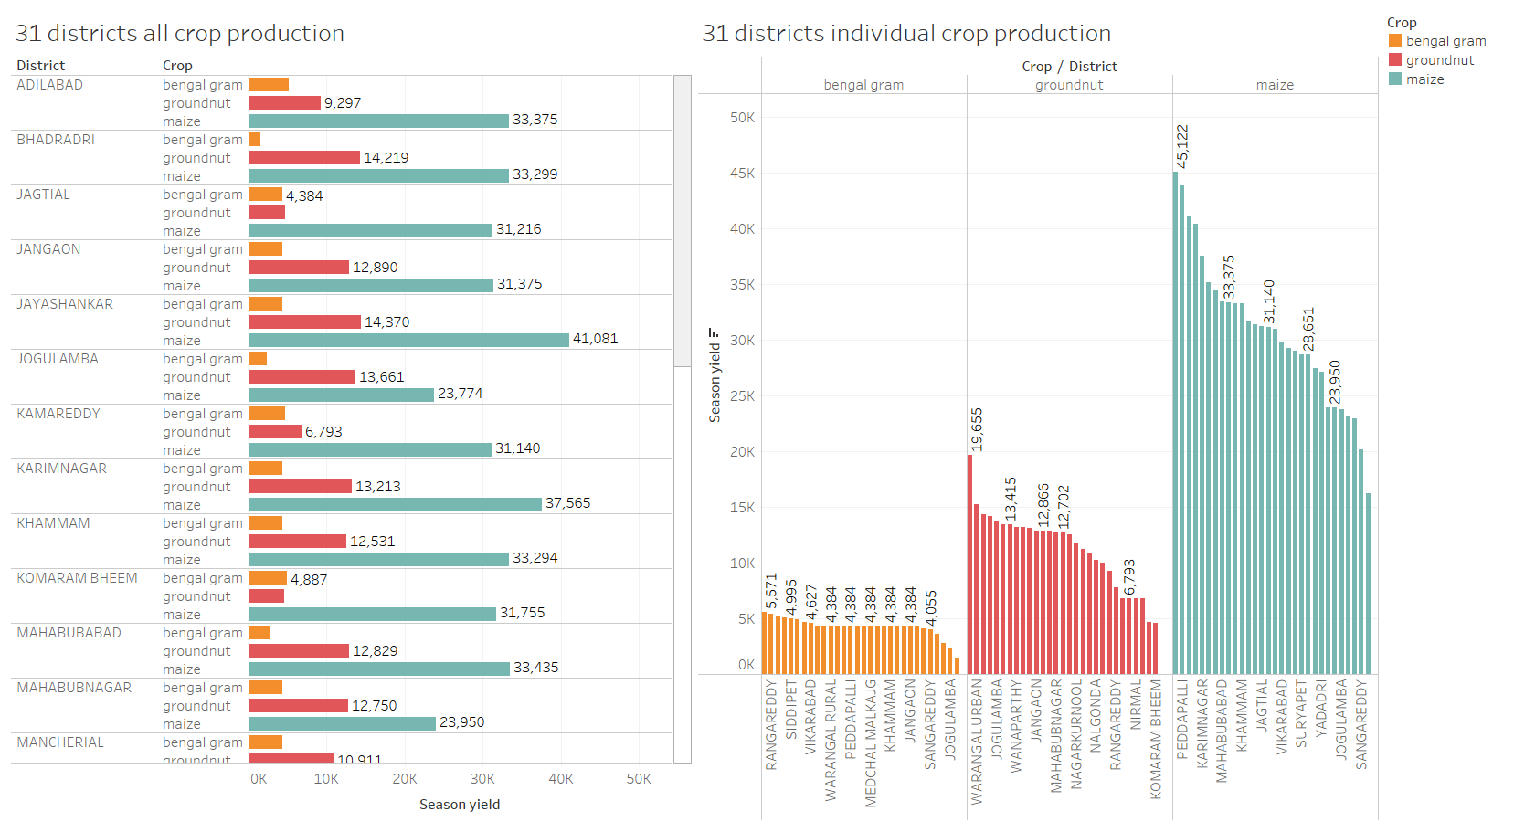
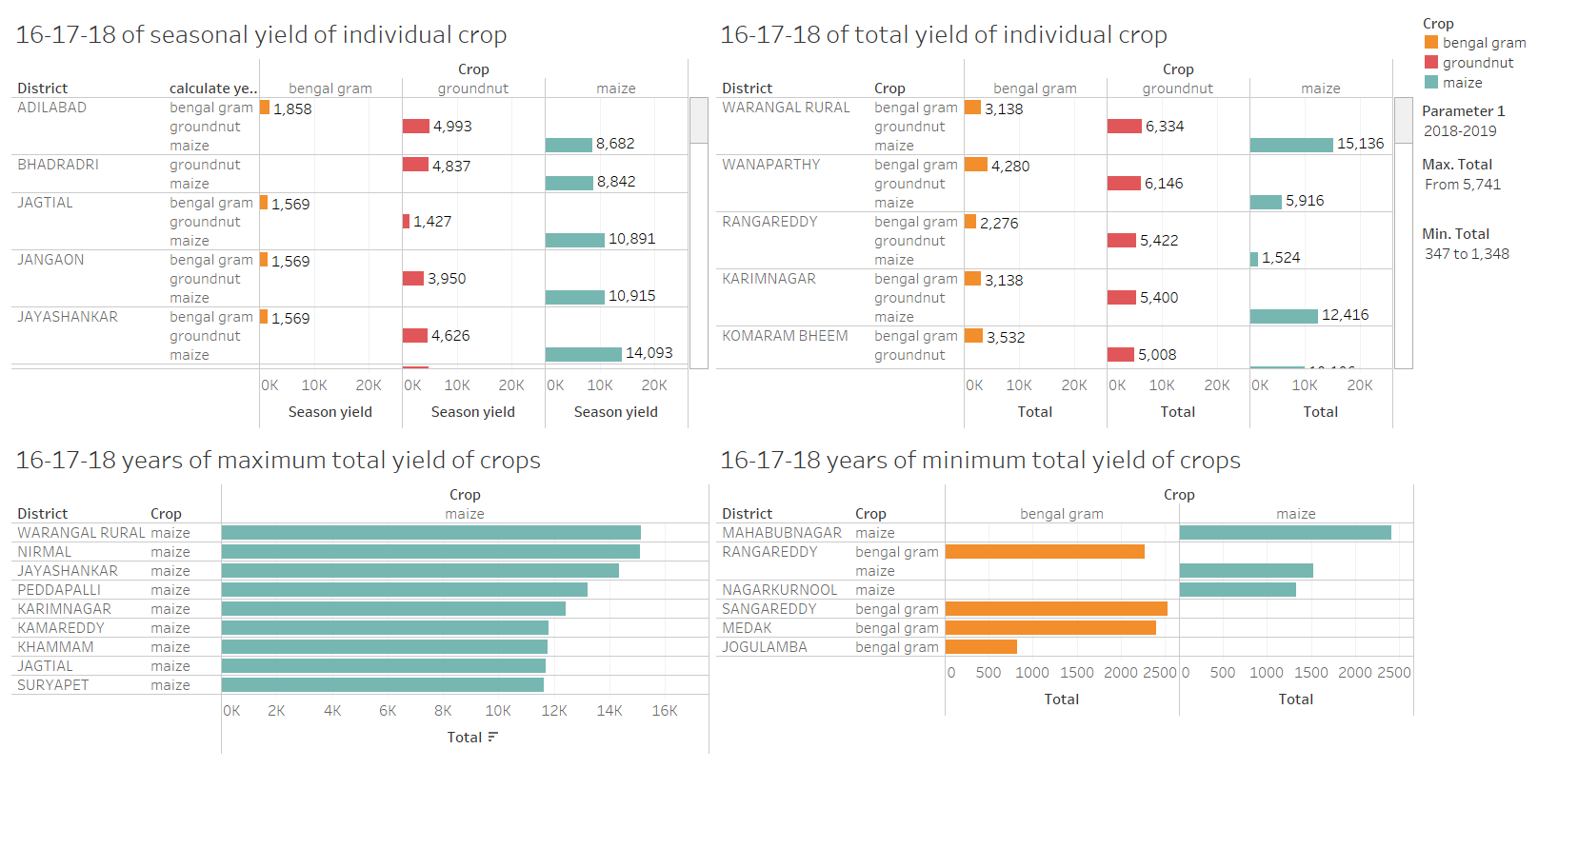
FIGHTING HIGH RISE PROBLEM - HUNGER
SIRINENI HARSHITHA, K V BHANU KIRAN, ABHINAV REDDY CHERLAKOLA
University of Massachusetts at Amherst
INTRODUCTION
RESULTS
CONCLUSIONS
Hunger is the most severe kind of poverty and hardship that exists. Up to 811 million people do not have enough to eat. Hungry individuals are unable to work to their full ability, they are more prone to illness. Hunger and malnutrition have many causes, they are Natural disasters, Poverty, Wars and conflicts, Inequality, Biased global trade, Poor governance, Waste of resources and climate change. The Agenda 2030 points the way to a fair world. For example, the German organization named Welthungerhilfe is concentrating on its core theme of food and nutrition security.
Undernourishment is not only a consequence of poverty, it also causes poverty, by being passed on from generation to generation – a vicious circle. If mothers-to-be are already undernourished, their children cannot develop correctly during the pregnancy and are frequently born prematurely and/or underweight. If a child already suffers from malnutrition in the womb, it has little chance of catching up on its underdevelopment. It often has a weakened immune system and is thus more susceptible to infectious diseases. The physical and mental development of the child is restricted, it has more difficulty concentrating and produces poorer school results. In addition, a malnourished child is also more prone to developing chronic diseases in adulthood. Both tend to lead to reduced physical and mental capacity in adulthood. And so earning opportunities decrease and the risk of poverty increases – the cycle continues. If a child already suffers from malnutrition in the womb, it has little chance of catching up on its underdevelopment. It often has a weakened immune system and is thus more susceptible to infectious diseases.
The physical and mental development of the child is restricted, it has more difficulty concentrating and produces poorer school results. In addition, a malnourished child is also more prone to developing chronic diseases in adulthood. Both tend to lead to reduced physical and mental capacity in adulthood. And so earning opportunities decrease and the risk of poverty increases – the cycle continues.
The ICAR (Indian Council of Agricultural Research), the ICMR (Indian Council of Medical Research), and the M.S. Swaminathan Research Foundation, in collaboration with BIRAC (Biotechnology Industry Research Assistance Council) and state governments, launched the initiative. The Zero Hunger program aims to eliminate hunger and ensure that people have access to enough healthy food by 2030. Ending all types of malnutrition and promoting sustainable agriculture are two other objectives of this Zero hunger.
In our study, we looked at agricultural growth in Telangana by, their district and their production rates for the years 2016, 2017 and 2018. Here, the main challenge to this hackathon is to provided in which district the minimum and maximum crops are produced. So that we can eradicate the hunger crisis in that district or know the reasons behind the less crop production.
The main aim of the selected Sustainable Growth Development challenge is to eradicate hunger in Telangana state and make it a zero-hunger state. Here, we have considered the dataset of Telangana district and made visualizations based on the crop the main three crops: Groundnut, Maize and Bengal gram. Here, we have used the tableau software and shown the visualization. We mainly concentrated on finding out the minimum and maximum production of crops in a particular district and saying out which regions can suffer with hunger in the upcoming years, if not concentrated now. The below two visualizations explains about the approach we have used to find out the hunger problem in the districts of Telangana.
A society in which everyone has enough food to live a healthy and active lifestyle, where hunger is rare, and food comes from smart, effective, and reduced food systems that are consistent with natural resource sustainability. The advantages to the impoverished and malnourished are evident: the chance to live a healthy and active lifestyle, for maybe the first time in their lives. However, the benefits to the wealthy are also worth noting: a world with less chance of war over nonrenewable, no need for expensive humanitarian aid, less welfare dependency migrations, and less environmental degradation.
In our challenge we selected the Telangana crop production for the years 2016-2017, 2017-2018, 2018-2019. The main objective was to find out the minimum crop production in the districts for the respective years and find out the reasons why the crop production is less. Finding out these minimum crop yields can help us to eradicate the hunger those districts in the coming years. In Telangana the districts named Mahbubnagar, Ranga Reddy, Nagar Kurnool, Sanga Reddy and Medak are the minimum productions of crops in the years 2018-2019, Similarly, if we do the analysis for every state by approximately 2030, India can become a hunger free country.
MATERIALS & METHODS
Problem statement: The problem statement we have selected is to find out the minimum and maximum production of crops in each district based on their total yields of the years 2016-2017,2017-2018,2018-2019. Problem objective: The objective of the problem is to find out in which districts the crop production is minimum so that we can concentrate on those districts to eradicate the hunger in future.
Methods and software used: Here we used Descriptive analysis to find approaches to our problems. The software we used here is Tableau to visualize and find solutions to the problem statement.
The agricultural crops corn, groundnut, and Bengal gram are vital in the agricultural landscape for the state of Telangana. In this challenge we have shown the visualizations based on these three crops. The dataset is provided by the Telangana State hackathon challenge for the years 2016-2017, 2017-2018 and 2018-2019 which consist of attributes: crop, district id, district, year, season, season yield, total yield. From this dataset we successfully found out which districts produces the maximum and minimum yields of crops. So that in the minimum districts we can concentrate more and find out the reasons for their less crop production and eradicate hunger.
In tableau workbook the story explains about the steps we have used to attain the results:
Sheet 1 in the story explains about the 31 districts all crop production based on their seasonal yields.
Sheet 2 in the story explains about the 31 districts individual crop production based on their seasonal yields.
Sheet 3 in the story explains about the sum of district wise total and seasonal yields of crop.
Sheet 4 in the story explains about the 16-17-18 seasonal yield of individual crops.
Sheet 5 in the story explains about the 16-17-18 total yield of individual crops.
Sheet 6 in the story explains about the 16-17-18 maximum total yield of individual crops.
Sheet 7 in the story explains about the 16-17-18 minimum total yield of individual crops.
Based on sheet 7 we can say the minimum production of crop in the year 2016, 2017, 2018 and find solutions in how to increase their crops production in future and how to eradicate hunger in those districts.
REFERENCES
Society, N. (2020). Sustainable Development Goal: Zero Hunger. Retrieved 1 October 2021, from https://www.nationalgeographic.org/encyclopedia/sustainable-development-goal-zero-hunger/
5 Ways USAID Is Helping to End World Hunger - World. (2017). Retrieved 1 October 2021, from https://reliefweb.int/report/world/5-ways-usaid-helping-end-world-hunger
Zero Hunger | World Food Programme. (2021). Retrieved 1 October 2021, from https://www.wfp.org/zero-hunger
NGO to take up 'Zero Hunger Challenge' in Khammam. (2021). Retrieved 1 October 2021, from https://telanganatoday.com/ngo-to-take-up-zero-hunger-challenge-in-khammam
Hunger Republic. (2020). Retrieved 1 October 2021, from https://telanganatoday.com/hunger-republic
Figure 2.1: The above dashboard explains about the state wise crop production and also about the individual crop production based on their seasonal yields.
Figure 2.2: The above dashboard explains about the year wise seasonal and total yields and also about the maximum and minimum production of crops in the selected year.

